Slide 1
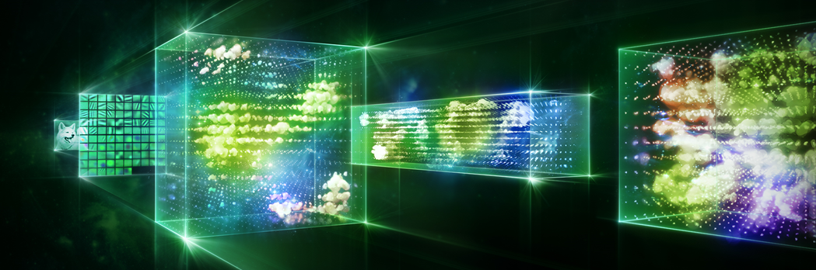


Image credit: Nvidia
3. Intro to Deep Learning
Melanie Swan
Philosophy Department, Purdue University
melanie@BlockchainStudies.org
Slides: http://slideshare.net/LaBlogga

Slide 2







Melanie Swan, Technology Theorist
Philosophy and Economic Theory, Purdue University, Indiana, USA
Founder, Institute for Blockchain Studies
Singularity University Instructor; Institute for Ethics and Emerging Technology Affiliate Scholar; EDGE Essayist; FQXi Advisor
Economics and Financial Theory Leadership
Traditional Markets Background
New Economies research group
https://www.facebook.com/groups/NewEconomies
Source: http://www.melanieswan.com, http://blockchainstudies.org/NSNE.pdf, http://blockchainstudies.org/Metaphilosophy_CFP.pdf

Slide 3
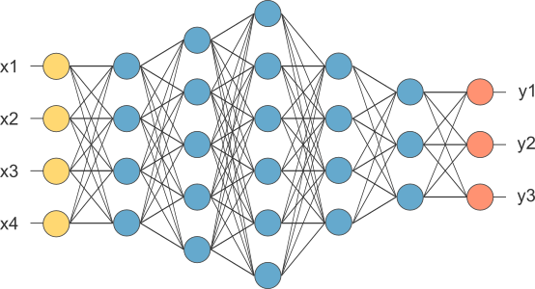
Agenda
Deep Learning
Definition
Technical details
Applications
Deep Qualia: Deep Learning and the Brain
Smart Network Convergence Theory
Conclusion
Image Source: http://www.opennn.net

Slide 4
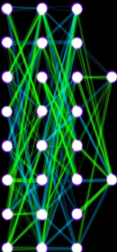
Deep Learning vocabulary What do these terms mean?
Deep Learning, Machine Learning, Artificial Intelligence
Perceptron, Artificial Neuron, Logit
Deep Belief Net, Artificial Neural Net, Boltzmann Machine
Google DeepDream, Google Brain, Google DeepMind
Supervised and Unsupervised Learning
Convolutional Neural Nets
Recurrent NN & LSTM (Long Short Term Memory)
Activation Function ReLU (Rectified Linear Unit)
Deep Learning libraries and frameworks
TensorFlow, Caffe, Theano, Torch, DL4J
Backpropagation, gradient descent, loss function

Slide 5

Conceptual Definition:
Deep learning is a computer program that can identify what something is
Technical Definition:
Deep learning is a class of machine learning algorithms in the form of a neural network that uses a cascade of layers (tiers) of processing units to extract features from data and make predictive guesses about new data
Source: Extending Jann LeCun, http://spectrum.ieee.org/automaton/robotics/artificial-intelligence/facebook-ai-director-yann-lecun-on-deep-learning

Slide 6

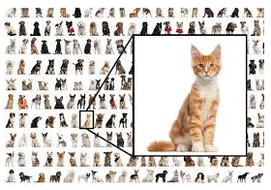
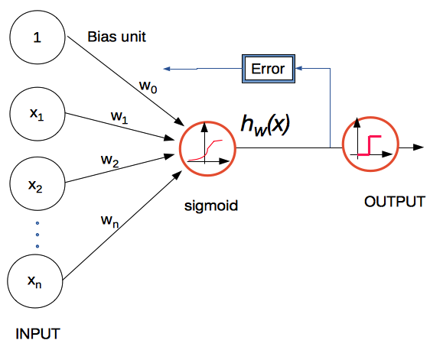
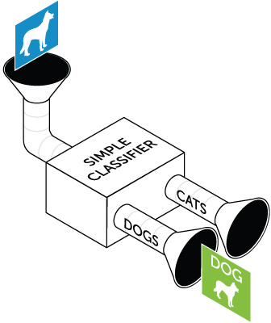
Deep Learning Theory
System is “dumb” (i.e. mechanical)
“Learns” with big data (lots of input examples) and trial-and-error guesses to adjust weights and bias to establish key features
Creates a predictive system to identity new examples
Same AI argument: big enough data is what makes a difference (“simple” algorithms run over large data sets)
Input: Big Data (e.g.; many examples)
Method: Trial-and-error guesses to adjust node weights
Output: system identifies new examples

Slide 7
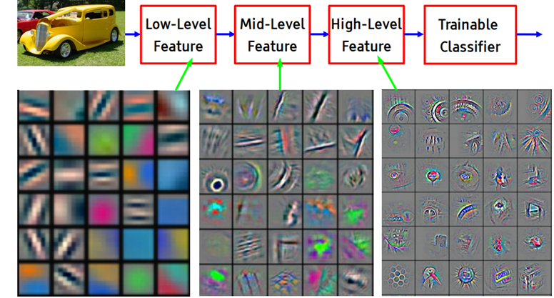
Sample task: is that a Car?
Create an image recognition system that determines which features are relevant (at increasingly higher levels of abstraction) and correctly identifies new examples
Source: Jann LeCun, http://www.pamitc.org/cvpr15/files/lecun-20150610-cvpr-keynote.pdf

Slide 8
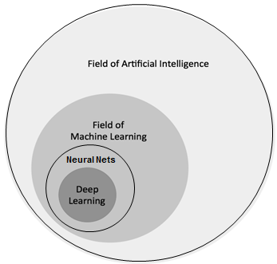
Broader Computer Science Context
Within the Computer Science discipline, in the field of Artificial Intelligence, Deep Learning is a class of Machine Learning algorithms, that are in the form of a Neural Network
Source: Machine Learning Guide, 9. Deep Learning

Slide 9
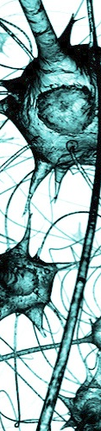
Statistical Mechanics Deep Learning is inspired by Physics
Sigmoid function suggested as a model for neurons, per statistical mechanical behavior (Jack Cowan)
Stationary solutions for dynamic models (asymmetric weights create an oscillator to model neuron signaling)
Hopfield Neural Network: content-addressable memory system with binary threshold nodes, converges to a local minimum (John Hopfield)
Can use an Ising model (of ferromagnetism) for neurons
Restricted Boltzmann Machine (Geoffrey Hinton)
Studied in theoretical physics, condensed matter field theory; Statistical Mechanics concepts: Renormalization, Boltzmann Distribution, Free Energies, Gibbs Sampling
Source: https://www.quora.com/Is-deep-learning-related-to-statistical-physics-particularly-network-science

Slide 10
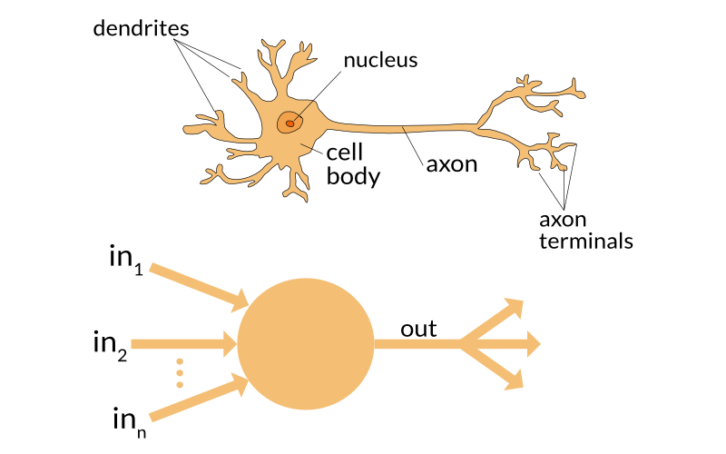
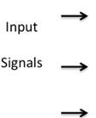
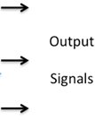
What is a Neural Net?
Motivation: create an Artificial Neural Network to solve problems the same way a human brain would

Slide 11
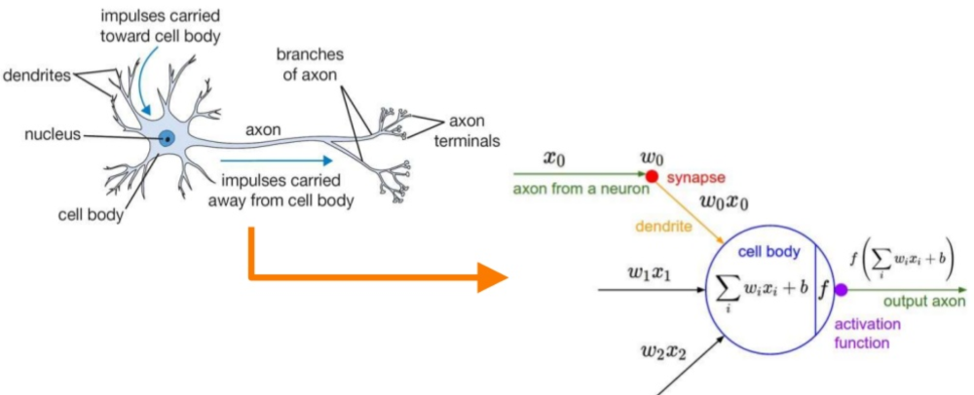
What is a Neural Net?
Structure: input-processing-output
Mimic neuronal signal firing structure of brain with computational processing units
Source: https://www.slideshare.net/ThomasDaSilvaPaula/an-introduction-to-machine-learning-and-a-little-bit-of-deep-learning, http://cs231n.github.io/convolutional-networks/

Slide 12
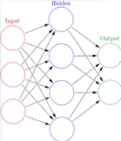
What is an Artificial Neural Network?
Collection of connected units called artificial neurons (analogous to axons in a biological brain)
Organized in layers of signaling cascades
Each neuron transmits a signal to another neuron
Neurons may have state
Represented by a number between 0 and 1
Variable parameters
Neurons may have a weight that varies as learning proceeds, which can increase or decrease the strength of the signal that it sends downstream
Neurons may have a threshold (bias) such that only if the aggregate signal is below (or above) that level is the downstream signal sent

Slide 13

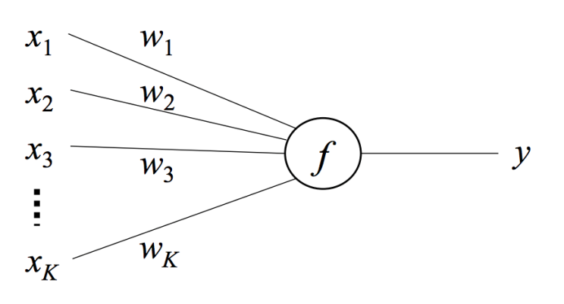
Why is it called Deep Learning?
Deep: Hidden layers (cascading tiers) of processing
“Deep” networks (3+ layers) versus “shallow” (1-2 layers)
Learning: Algorithms “learn” from data by modeling features and updating probability weights assigned to feature nodes in testing how relevant specific features are in determining the general type of item
Deep: Hidden processing layers
Learning: Updating probability weights re: feature importance

Slide 14
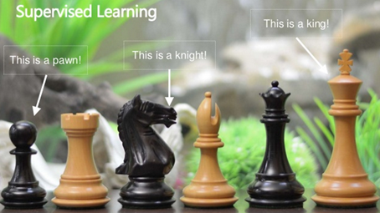
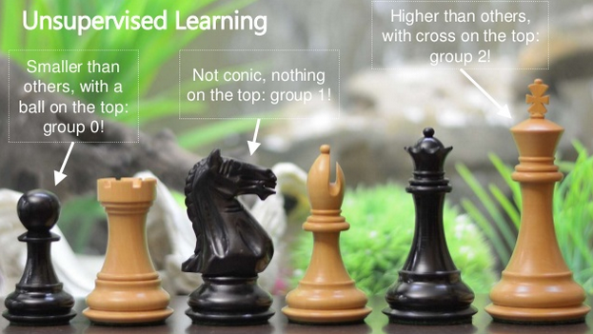
Supervised and Unsupervised Learning
Supervised (classify labeled data)
Unsupervised (find patterns in unlabeled data)
Source: https://www.slideshare.net/ThomasDaSilvaPaula/an-introduction-to-machine-learning-and-a-little-bit-of-deep-learning

Slide 15



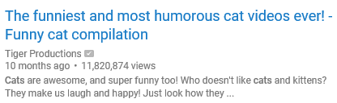
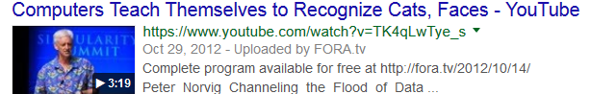
Early success in Supervised Learning (2011)
YouTube: user-classified data perfect for Supervised Learning
Source: Google Brain: Le, QV, Dean, Jeff, Ng, Andrew, et al. 2012. Building high-level features using large scale unsupervised learning. https://arxiv.org/abs/1112.6209

Slide 16
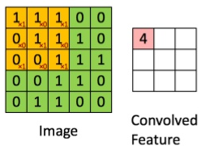
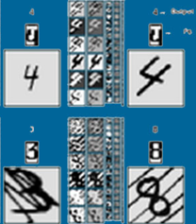
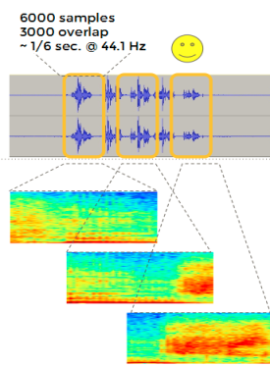
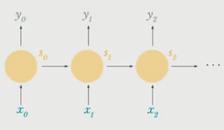
2 main kinds of Deep Learning neural nets
Convolutional Neural Nets
Image recognition
Convolve: roll up to higher levels of abstraction in feature sets
Recurrent Neural Nets
Speech, text, audio recognition
Recur: iterate over sequential inputs with a memory function
LSTM (Long Short-Term Memory) remembers sequences and avoids gradient vanishing
Source: Yann LeCun, CVPR 2015 keynote (Computer Vision ), "What's wrong with Deep Learning" http://t.co/nPFlPZzMEJ

Slide 17
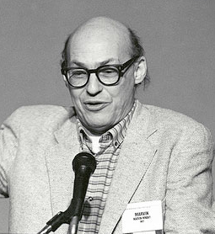
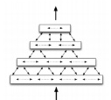

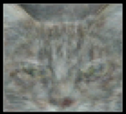
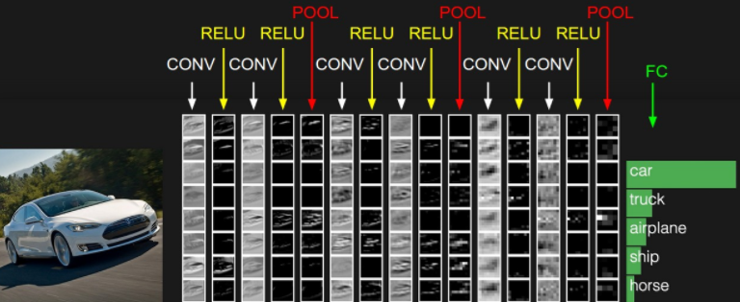
Image Recognition and Computer Vision
History
Marv Minsky, 1966
“summer project”
Jeff Hawkins, 2004, Hierarchical Temporal Memory (HTM)
Quoc Le, 2011, Google Brain cat recognition
Current state of the art - 2017
Convolutional net for autonomous driving, http://cs231n.github.io/convolutional-networks/
Source: Quoc Le, https://arxiv.org/abs/1112.6209; Yann LeCun, NIPS 2016, https://drive.google.com/file/d/0BxKBnD5y2M8NREZod0tVdW5FLTQ/view

Slide 18
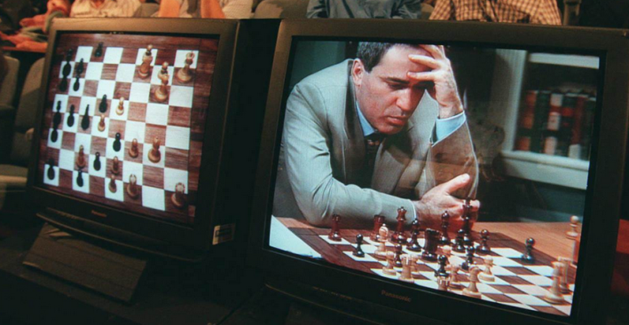
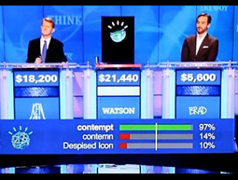
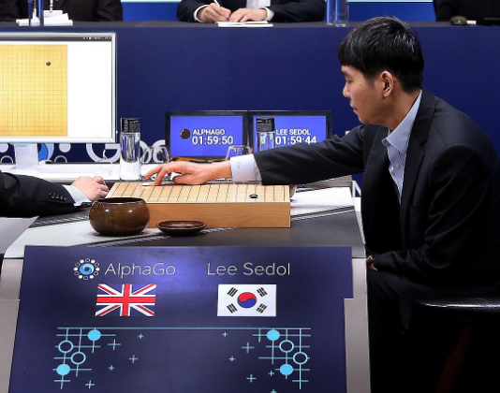
Progression in AI Deep Learning machines
Deep Blue, 1997
Watson, 2011
AlphaGo, 2016
Hard-coded AI machine
Deep Learning prototype
Deep Learning machine
Single-purpose AI:
Hard-coded rules
Question-answering AI:
Natural-language processing
Multi-purpose AI:
Algorithm detects rules, reusable template

Slide 19
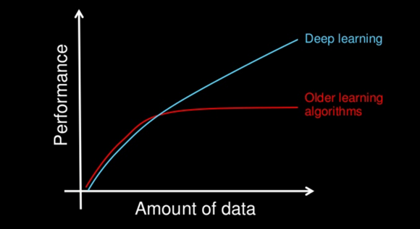
Why do we need Deep Learning?
A contemporary data science method to keep up with the growth in data, older learning algorithms no longer performing
Source: http://blog.algorithmia.com/introduction-to-deep-learning-2016

Slide 20
Agenda
Deep Learning
Definition
Technical details
Applications
Deep Qualia: Deep Learning and the Brain
Smart Network Convergence Theory
Conclusion
Image Source: http://www.opennn.net

Slide 21
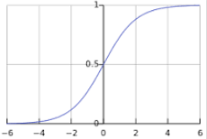
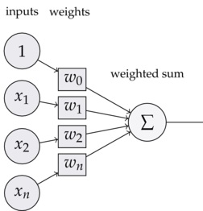
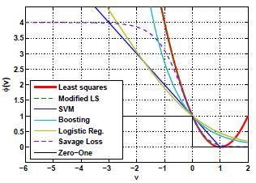
3 Key Technical Principles of Deep Learning
Sigmoid Function
Perceptron Structure
Loss Function
Squash values into Sigmoidal S-curve
-Binary values (Y/N, 0/1)
-Probability values (0 to 1)
-Tanh values 9(-1) to 1)
Core processing unit
(input-processing-output)
Levers: weights and bias
Reduce combinatoric dimensionality
What
Non-linear formulation as a logistic regression problem means greater mathematical manipulation
“Dumb” system learns by adjusting parameters and checking against outcome
Loss function optimizes efficiency of solution
Why

Slide 22
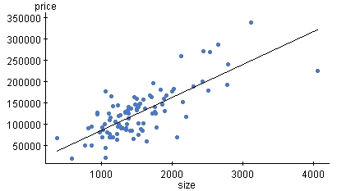
Linear Regression
House price vs. Size (square feet)
House price
y=mx+b
Size (square feet)
Source: https://www.statcrunch.com/5.0/viewreport.php?reportid=5647

Slide 23
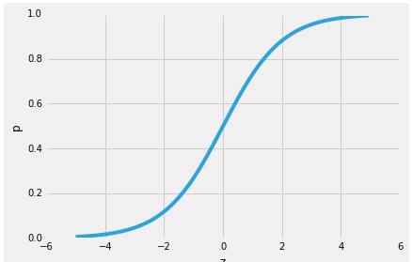
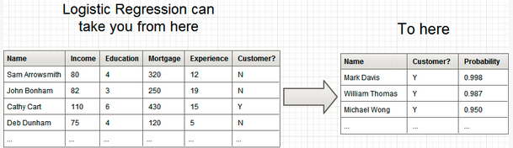
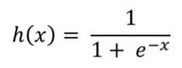
Logistic Regression
Source: http://www.simafore.com/blog/bid/99443/Understand-3-critical-steps-in-developing-logistic-regression-models

Slide 24
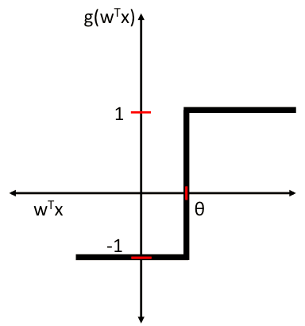
Logistic Regression
Higher-order mathematical formulation
Sigmoid function
S-shaped and bounded
Maps the whole real axis into a finite interval (0-1)
Non-linear
Can fit probability
Can apply optimization techniques
Deep Learning classification predictions are in the form of a probability value
Sigmoid Function
Unit Step Function
Source: https://www.quora.com/Logistic-Regression-Why-sigmoid-function

Slide 25


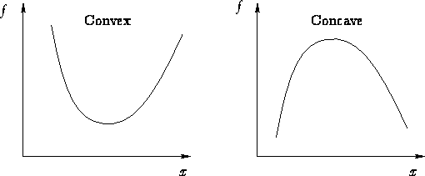
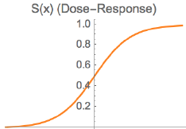
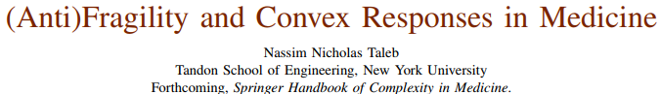
Sigmoid function: Taleb
Thesis: if can map a phenomenon onto a sigmoid curve (“convexify” it), then can control its risk
Antifragility = convexity = risk-manageable
Fragility = concavity
Non-linearity of dose-response in medicine, and therefore suggested treatment optimality
Source: http://www.fooledbyrandomness.com/medicine.pdf

Slide 26
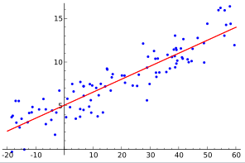
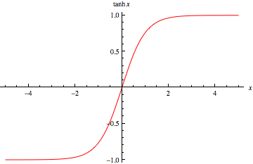
Regression
Linear Regression
Logistic Regression (Sigmoid function)
(0-1) or Tanh ((-1)-1)
Linear regression
Predict continuous set of values (house prices)
Logistic regression
Predict binary outcomes:
Perceptron (0 or 1)
Predict probabilities:
Sigmoid Neuron (values 0-1)
Tanh Hyperbolic Tangent Neuron (values (-1)-1)

Slide 27
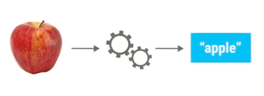
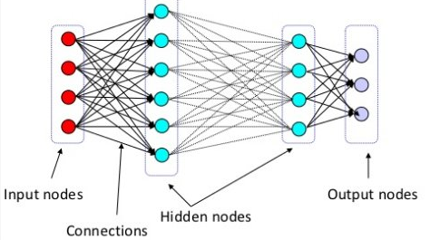
Deep Learning Architecture
Source: Michael A. Nielsen, Neural Networks and Deep Learning

Slide 28
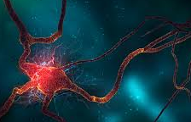
Processing Unit, Perceptron, Neuron
Unit (processing unit, logistic regression unit), perceptron (“multilayer perceptron”), artificial neuron
1. Input
2. Hidden layers
3. Output
X
X
X
X
X
X
X
X
X
X
X
X
X
X
X
X
X
X
X
X
X
X
X
X
X
X
X
X
X
X
X
X
X
X
X
Source: http://deeplearning.stanford.edu/tutorial

Slide 29
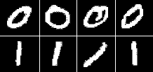
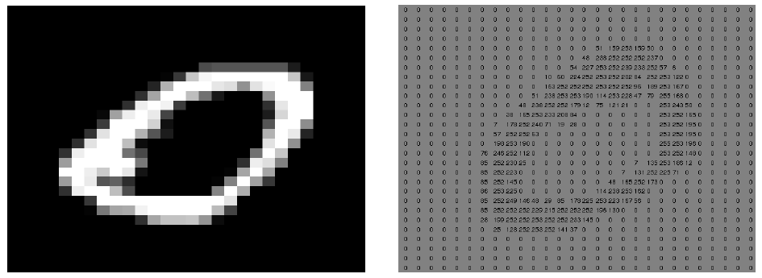
Example: Image recognition
Obtain training data set
Digitize pixels (convert images to numbers)
Divide image into 28x28 grid, assign a value (0-255) to each square based on brightness
Read into vector (array; list of numbers)
28x28 = 784 elements per image)
Source: Quoc V. Le, A Tutorial on Deep Learning, Part 1: Nonlinear Classifiers and The Backpropagation Algorithm, 2015, Google Brain, https://cs.stanford.edu/~quocle/tutorial1.pdf

Slide 30
Deep Learning Architecture
4. Load spreadsheet of vectors into deep learning system
Each row of spreadsheet (784-element array) is an input
1. Input
2. Hidden layers
3. Output
Vector data
X
X
X
X
X
784-element array
X
X
X
X
X
X
X
X
X
X
X
X
X
X
X
X
X
X
X
X
X
X
X
X
X
X
X
X
X
X
Source: http://deeplearning.stanford.edu/tutorial; MNIST dataset: http://yann.lecun.com/exdb/mnist

Slide 31
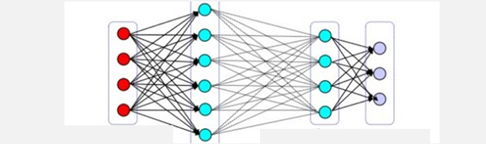
What happens in the Hidden Layers?
First layer learns primitive features (line, edge, tiniest unit of sound) by finding combinations of the input vector data that occur more frequently than by chance
Logistic regression performed and encoded at each processing node (Y/N (0,1)), does this example have this feature?
Feeds these basic features to next layer, which trains itself to recognize slightly more complicated features (corner, combination of speech sounds)
Feeds features to new layers until recognizes full objects
Source: Michael A. Nielsen, Neural Networks and Deep Learning

Slide 32





Image Recognition Higher Abstractions of Feature Recognition
Edges
Object Parts (combinations of edges)
Object Models
Source: Jann LeCun, http://www.pamitc.org/cvpr15/files/lecun-20150610-cvpr-keynote.pdf

Slide 33

Speech, Text, Audio Recognition Sequence-to-sequence Recognition + LSTM
Source: Andrew Ng

Slide 34

Example: NVIDIA Facial Recognition
First hidden layer extracts all possible low-level features from data (lines, edges, contours); next layers abstract into more complex features of possible relevance
Source: Nvidia

Slide 35


Deep Learning
Source: Quoc V. Le et al, Building high-level features using large scale unsupervised learning, 2011, https://arxiv.org/abs/1112.6209

Slide 36

Deep Learning Architecture
1. Input
2. Hidden layers
3. Output
(0,1)
Source: Michael A. Nielsen, Neural Networks and Deep Learning

Slide 37
Mathematical methods update weights
Linear algebra: matrix multiplications of input vectors
Statistics: logistic regression units (Y/N (0,1)), probability weighting and updating, inference for outcome prediction
Calculus: optimization (minimization), gradient descent in back-propagation to avoid local minima with saddle points
Inference
Guess
Actual
1. Input
2. Hidden layers
3. Output
Feed-forward pass
(0,1)
X
.5
X
.5
X
.5
X
X
0
0
.75
Backward pass to update probabilities
X
.5
X
.5
X
.5
X
X
1
0
.25
X
X
X
X
X
Source: http://deeplearning.stanford.edu/tutorial; MNIST dataset: http://yann.lecun.com/exdb/mnist

Slide 38


More complicated in actual use
Convolutional neural net scale-up for number recognition
Example data: MNIST dataset
http://yann.lecun.com/exdb/mnist
Source: http://www.kdnuggets.com/2016/04/deep-learning-vs-svm-random-forest.html

Slide 39

Structure of a Node: Computation Graph
Edge
(input value)
3
Node (operation)
Add
Edge
(output value)
??
Edge
(input value)
4
Architecture
Example 1
3
Mult
??
4
Example 2

Slide 40

Neural net unit: perceptron, neuron, node
Sigmoid function means all inputs and outputs in the system are (0,1)
(0,1)
Oper-ation
(0,1)
(0,1)
(0,1)
Source: http://neuralnetworksanddeeplearning.com/chap1.html

Slide 41

Other parameters: weights and bias
Weight and bias are variable parameters that get adjusted as the system iterates and learns
Values have Weights
Operation node has Bias
Values have Weights
Operation node has Bias
B=3
= 0
B=3
W₁ = (-2)
W₁ = (-2)
Output
= 0
= 0
W₂ = (-2)
W₂ = (-2)
Input (0,1) X₁, X₂
W₁*X₁ + W₂*X₂ + Bias = n
Output (0,1)
0,0
(-2)*0 + (-2)*0 + 3 = 3
1
Weight and Bias are “randomly” assigned at the beginning: (here (-2) and 3)
Mimics NAND gate
0,1
(-2)*0 + (-2)*1 + 3 = 1
1
1,0
(-2)*1 + (-2)*0 + 3 = 1
1
1,1
(-2)*1 + (-2)*1 + 3 = (-1)
0
Source: http://neuralnetworksanddeeplearning.com/chap1.html

Slide 42

Actual: same structure, more complicated

Slide 43



Neural net: massive scale-up of nodes
Source: http://neuralnetworksanddeeplearning.com/chap1.html

Slide 44

Same Structure

Slide 45


How does the neural net actually learn?
Structural system based on cascading layers of neurons with variable parameters: weight and bias
Vary the weights and biases to see if a better outcome is obtained
Repeat until the net correctly classifies the data
Source: http://neuralnetworksanddeeplearning.com/chap2.html

Slide 46



Backpropagation
Problem: Inefficient to test the combinatorial explosion of all possible parameter variations
Solution: Backpropagation (1986 Nature paper)
Backpropagation is an optimization method used to calculate the error contribution of each neuron after a batch of data is processed
Source: http://neuralnetworksanddeeplearning.com/chap2.html

Slide 47

Backpropagation of error
Calculate the total error
Calculate the contribution to the error at each step going backwards
Variety of Error Calculation methods: Mean Square Error (MSE), sum of squared errors of prediction (SSE), Cross-Entropy (Softmax), Softplus

Slide 48

Backpropagation
Heart of Deep Learning
Backpropagation: algorithm dynamically calculates the gradient (derivative) of the loss function with respect to the weights in a network to find the minimum and optimize the function from there
Algorithms optimize the performance of the network by adjusting the weights, e.g.; in the gradient descent algorithm
Error and gradient are computed for each node
Intermediate errors transmitted backwards through the network (backpropagation)
Objective: optimize the weights so that the neural network can learn how to correctly map arbitrary inputs to outputs
Source: http://briandolhansky.com/blog/2013/9/27/artificial-neural-networks-backpropagation-part-4, https://mattmazur.com/2015/03/17/a-step-by-step-backpropagation-example/

Slide 49


Gradient Descent
Gradient: derivative to find the minimum of a function
Gradient descent: optimization algorithm to find the biggest errors (minima) most quickly
Error = MSE, log loss, cross-entropy; e.g.; least correct predictions to correctly identify data
Source: http://briandolhansky.com/blog/2013/9/27/artificial-neural-networks-backpropagation-part-4

Slide 50



Loss Function
Optimization Technique
Mathematical tool used in statistics, finance, decision theory, biological modeling, computational neuroscience
State as non-linear equation to optimize
Minimize loss or cost
Maximize reward, utility, profit, or fitness
Loss function links instance of an event to its cost
Accident (event) means $1,000 damage on average (cost)
5 cm height (event) confers 5% fitness advantage (reward)
Deep learning: system feedback loop
Use penalty cost for incorrect classifications to train system
CNN (classification): cross-entropy; RNN (regression): MSE
Laplace

Slide 51

Overfitting
Regularization
Introduce additional information such as a lambda parameter in the cost function (to update the theta parameters in the gradient descent algorithm)
Dropout: prevent complex adaptations on training data by dropping out units (both hidden and visible)
Test new datasets

Slide 52


Research Topics
Layer depth vs. height (1x9, 3x3, etc.); L1/2 slow-downs
Backpropagation, gradient descent, loss function
Saddle-free optimization, vanishing gradients
Composition of non-linearities
Non-parametric manifold learning, auto-encoders
Activation maximization
Synthesizing preferred inputs for neurons
Source: http://cs231n.github.io/convolutional-networks, https://arxiv.org/abs/1605.09304, https://www.iro.umontreal.ca/~bengioy/talks/LondonParisMeetup_15April2015.pdf

Slide 53



Advanced Deep Learning Architectures
Deep Belief Network
Connections between layers not units
Establish weighting guesses for processing units before run deep learning system
Used to pre-train systems to assign initial probability weights (more efficient)
Deep Boltzmann Machine
Stochastic recurrent neural network
Runs learning on internal representations
Represent and solve combinatoric problems
Deep Belief Network
Deep Boltzmann Machine
Source: http://prog3.com/sbdm/blog/zouxy09/article/details/8781396

Slide 54



Convolutional net: Image Enhancement
Google DeepDream: Convolutional neural network enhances (potential) patterns in images; deliberately over-processing images
Source: Georges Seurat, Un dimanche après-midi à l'Île de la Grande Jatte, 1884-1886; http://web.cs.hacettepe.edu.tr/~aykut/classes/spring2016/bil722; Google DeepDream uses algorithmic pareidolia (seeing an image when none is present) to create a dream-like hallucinogenic appearance

Slide 55

Hardware and Software Tools

Slide 56



Deep Learning frameworks and libraries
Source: http://www.infoworld.com/article/3163525/analytics/review-the-best-frameworks-for-machine-learning-and-deep-learning.html#tk.ifw-ifwsb

Slide 57




What is TensorFlow?
Google’s open-source machine learning library
“Tensor” = multidimensional arrays used in NN operations
Computation graph
Design in TensorFlow
TensorBoard (TensorFlow) visualization
Python code invoking TensorFlow
Source: https://www.youtube.com/watch?v=uHaKOFPpphU

Slide 58


Hardware
Advances in chip design
GPU chips (graphics processing unit): 3D graphics cards designed to do fast matrix multiplication
Google TPU chip (tensor processing unit): custom ASICs for machine learning, used in AlphaGo
TPUs process matrix multiplications without storing intermediate values in memory
NVIDIA DGX-1 integrated deep learning system
Eight Tesla P100 GPU accelerators
Google TPU chip (Tensor Processing Unit), 2016
NVIDIA DGX-1
Deep Learning System
Source: http://www.techradar.com/news/computing-components/processors/google-s-tensor-processing-unit-explained-this-is-what-the-future-of-computing-looks-like-1326915

Slide 59


USB and Browser-based Machine Learning
Intel: Movidius Visual Processing Unit (VPU): USB ML for IOT
Security cameras, industrial equipment, robots, drones
Apple: ML acquisition Turi (Dato)
Browser-based Deep Learning
ConvNetJS; TensorFire
Javascript library to run Deep Learning (Neural Networks) in a browser
Smart Network in a browser
JavaScript Deep Learning
Blockchain EtherWallets
Source: http://cs.stanford.edu/people/karpathy/convnetjs/, http://www.infoworld.com/article/3212884/machine-learning/machine-learning-comes-to-your-browser-via-javascript.html

Slide 60


How big are Deep Learning neural nets?
Google Deep Brain cat recognition, 2011
1 billion connections, 10 million images (200x200 pixel), 1,000 machines (16,000 cores), 3 days, each instantiation of the network spanned 170 servers, and 20,000 object categories
State of the art, 2016-2017
NVIDIA facial recognition, 100 million images, 10 layers, 1 bn parameters, 30 exaflops, 30 GPU days
Google, 11.2-billion parameter system
Lawrence Livermore Lab, 15-billion parameter system
Digital Reasoning, cognitive computing (Nashville TN), 160 billion parameters, trained on three multi-core computers overnight
Source: https://futurism.com/biggest-neural-network-ever-pushes-ai-deep-learning, Digital Reasoning paper: https://arxiv.org/pdf/1506.02338v3.pdf

Slide 61
Agenda
Deep Learning
Definition
Technical details
Applications
Deep Qualia: Deep Learning and the Brain
Smart Network Convergence Theory
Conclusion
Image Source: http://www.opennn.net

Slide 62




Applications: Cats to Cancer to Cognition
Computational imaging: Machine learning for 3D microscopy
https://www.nature.com/nature/journal/v523/n7561/full/523416a.html
Source: Yann LeCun, CVPR 2015 keynote (Computer Vision ), "What's wrong with Deep Learning" http://t.co/nPFlPZzMEJ

Slide 63

Tumor Image Recognition
Computer-Aided Diagnosis with Deep Learning Architecture
Breast tissue lesions in images and pulmonary nodules in CT Scans
Source: https://www.nature.com/articles/srep24454

Slide 64



Melanoma Image Recognition
Source: http://www.nature.com/nature/journal/v542/n7639/full/nature21056.html

Slide 65






DIY Image Recognition: use Contrast
Apple or Orange?
Melanoma risk or healthy skin?
Degree of contrast in photo colors?
How many orange pixels?
Source: https://developer.clarifai.com/modelshttps://developer.clarifai.com/models

Slide 66


Deep Learning and Genomics
Large classes of hypothesized but unknown correlations
Genotype-phenotype disease linkage unknown
Computer-identifiable patterns in genomic data
CNN: genome symmetries; RNN: textual analysis
Source: http://ieeexplore.ieee.org/document/7347331

Slide 67

Deep Learning and the Brain

Slide 68


Deep Qualia machine? General purpose AI Mutual inspiration of neurological and computing research
Deep learning neural networks are inspired by the structure of the cerebral cortex
The processing unit, perceptron, artificial neuron is the mathematical representation of a biological neuron
In the cerebral cortex, there can be several layers of interconnected perceptrons

Slide 69




Deep Qualia machine?
Visual cortex is hierarchical with intermediate layers
The ventral (recognition) pathway in the visual cortex has multiple stages: Retina - LGN - V1 - V2 - V4 - PIT – AIT
Human brain simulation projects
Swiss Blue Brain project, European Human Brain Project
Source: Jann LeCun, http://www.pamitc.org/cvpr15/files/lecun-20150610-cvpr-keynote.pdf

Slide 70


Social Impact of Deep Learning
WHO estimates 400 million people without access to essential health services
6% in extreme poverty due to healthcare costs
Next leapfrog technology: Deep Learning
Last-mile build out of brick-and-mortar clinics does not make sense in era of digital medicine
Medical diagnosis via image recognition, natural language processing symptoms description
Convergence Solution: Digital Health Wallet
Deep Learning medical diagnosis + Blockchain-based EMRs (electronic medical records)
Empowerment Effect: Deep learning = “tool I use,” not hierarchically “doctor-administered”
Digital Health Wallet:
Deep Learning diagnosis
Blockchain-based EMRs
Source: http://www.who.int/mediacentre/news/releases/2015/uhc-report/en/

Slide 71
Agenda
Deep Learning
Definition
Technical details
Applications
Deep Qualia: Deep Learning and the Brain
Smart Network Convergence Theory
Conclusion
Image Source: http://www.opennn.net

Slide 72


New Technology
Better horse AND new car

Slide 73

Smart Network Convergence Theory
Smart networks are computing networks with intelligence built in such that identification and transfer is performed by the network itself through protocols that automatically identify (deep learning), and validate, confirm, and route transactions (blockchain) within the network

Slide 74

Smart Network Convergence Theory
Two Fundamental Eras of Network Computing
Network intelligence “baked in” to smart networks
Deep Learning algorithms for predictive identification
Blockchains to transfer value, confirm authenticity
Source: Expanded from Mark Sigal, http://radar.oreilly.com/2011/10/post-pc-revolution.html

Slide 75





Blockchain is the tamper-resistant distributed ledger software underlying cryptocurrencies such as Bitcoin, for the secure transfer of money, assets, and information via the Internet without a third-party intermediary
Source: http://www.amazon.com/Bitcoin-Blueprint-New-World-Currency/dp/1491920491

Slide 76



Blockchain Deep Learning nets
Provide increasingly sophisticated automated network computational infrastructure
Make predictive guesses of reality states of the world
Predictive inference (deep learning) and cryptographic nonce-guesses (blockchain)
Instantiate decentralization
Hierarchical models do not scale

Slide 77



Next Phase
Put Deep Learning systems on the Internet
Deep Learning Blockchain Networks
Combine Deep Learning and Blockchain Technology
Blockchain offers secure audit ledger of activity
Advanced computational infrastructure to tackle larger-scale problems
Genomic disease, protein modeling, energy storage, global financial risk assessment, voting, astronomical data

Slide 78



Example: Autonomous Driving
Requires the smart network functionality of deep learning and blockchain
Deep Learning: identify what things are
Convolutional neural nets core element of machine vision system
Blockchain: secure automation technology
Track arbitrarily-many fleet units
Legal accountability
Software upgrades
Remuneration

Slide 79



The Very Small Blockchain Deep Learning nets in Cells
Medical nanorobotics for cell repair
Deep Learning: identify what things are (diagnosis)
Blockchain: secure automation technology
Bio-cryptoeconomics: secure automation of medical nanorobotics for cell repair
Medical nanorobotics as coming-onboard repair platform for the human body
High number of agents and “transactions”
Identification and automation is obvious
Sources: Swan, M. Blockchain Thinking: The Brain as a DAC (Decentralized Autonomous Corporation). Technology and Society Magazine, IEEE 2015; 34(4): 41-52 , https://www.slideshare.net/lablogga/biocryptoeconomy-smart-contract-blockchainbased-bionano-repair-dacs

Slide 80



The Very Large Blockchain Deep Learning nets in Space
Automated space construction bots/agents
Deep Learning: identify what things are (classification)
Blockchain: secure automation technology
Applications: asteroid mining, terraforming, radiation-monitoring, space-based solar power, debris tracking net

Slide 81
Agenda
Deep Learning
Definition
Technical details
Applications
Deep Qualia: Deep Learning and the Brain
Smart Network Convergence Theory
Conclusion
Image Source: http://www.opennn.net

Slide 82

Our human future
Are we doomed?

Slide 83






Human-machine collaboration
Team-members excel at different things
Differently-abled agents in society
Source: Swan, M. (2017). Is Technological Unemployment Real? In: Surviving the Machine Age. http://www.springer.com/us/book/9783319511641

Slide 84
Conceptual Definition:
Deep learning is a computer program that can identify what something is
Technical Definition:
Deep learning is a class of machine learning algorithms in the form of a neural network that uses a cascade of layers (tiers) of processing units to extract features from data and make predictive guesses about new data
Source: Extending Jann LeCun, http://spectrum.ieee.org/automaton/robotics/artificial-intelligence/facebook-ai-director-yann-lecun-on-deep-learning

Slide 85
Deep Learning Theory
System is “dumb” (i.e. mechanical)
“Learns” with big data (lots of input examples) and trial-and-error guesses to adjust weights and bias to establish key features
Creates a predictive system to identity new examples
Same AI argument: big enough data is what makes a difference (“simple” algorithms run over large data sets)
Input: Big Data (e.g.; many examples)
Method: Trial-and-error guesses to adjust node weights
Output: system identifies new examples

Slide 86
3 Key Technical Principles of Deep Learning
Sigmoid Function
Perceptron Structure
Loss Function
Squash values into probability function (Sigmoid (0-1);
Tanh ((-1)-1))
Core processing unit
(input-processing-output)
Levers: weights and bias
Reduce combinatoric dimensionality
What
Formulate as a logistic regression problem for greater mathematical manipulation
“Dumb” system learns by adjusting parameters and checking against outcome
Loss function optimizes efficiency of solution
Why

Slide 87



Conclusion
Next-generation global infrastructure: Deep Learning Blockchain Networks merging deep learning systems and blockchain technology
Smart Network Convergence Theory: pushing more complexity and automation through Internet pipes
Blockchain Deep Learning nets: Ability to identify what something is (machine learning) and securely verify and transact it (blockchain)

Slide 88







Resources
Neural Networks and Deep Learning, Michael Nielsen, http://neuralnetworksanddeeplearning.com/
Deep Learning, Ian Goodfellow, Yoshua Bengio, Aaron Courville, http://www.deeplearningbook.org/Machine learning and deep neural nets
Machine Learning Guide podcast, Tyler Renelle, http://ocdevel.com/podcasts/machine-learning
notMNIST dataset http://yaroslavvb.blogspot.com/2011/09/notmnist-dataset.html
Metacademy; Fast.ai; Keras.io
https://www.deeplearning.ai/
Distill (visual ML journal) http://distill.pub
Source: http://cs231n.stanford.edu

Slide 89
Image credit: Nvidia
3. Intro to Deep Learning
Melanie Swan
Philosophy Department, Purdue University
melanie@BlockchainStudies.org
Slides: http://slideshare.net/LaBlogga

Slide 90

Deep Learning Taxonomy
AI (artificial intelligence)
Machine learning
Other methods
Supervised learning
(labeled data: classification)
Unsupervised learning
(unlabeled data: pattern recognition)
Reinforcement learning
Deep learning
(5-20 layers)
Shallow learning
(1-2 layers)
Neural Nets (NN)
Other methods
Bayesian inference
Convolutional nets (images)
Support Vector Machines
Recurrent nets (text, speech)
Decision trees
K-means clustering
K-nearest neighbor
Source: Machine Learning Guide, 9. Deep Learning;

Slide 91

Kinds of Deep Learning Systems What Deep Learning net to choose?
Supervised algorithms (classify labeled data)
Image (object) recognition
Convolutional net (image processing), deep belief network, recursive neural tensor network
Text analysis (name recognition, sentiment analysis)
Recurrent net (iteration; character level text), recursive neural tensor network
Speech recognition
Recurrent net
Unsupervised algorithms (find patterns in unlabeled data)
Boltzmann machine or autoencoder
Source: Yann LeCun, CVPR 2015 keynote (Computer Vision ), "What's wrong with Deep Learning" http://t.co/nPFlPZzMEJ

